Slide 1
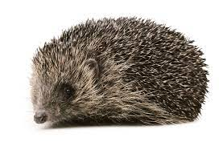
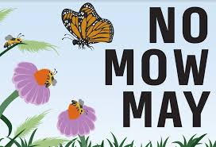
Eco-Schools Assembly
School Grounds

Slide 2
Why are hedgehogs important?
They have a key role in maintaining a healthy eco-system, as they work to control insect populations.
They keep gardens healthy by eating beetles, caterpillars, worms and other invertebrates.
They keep crops and plants in great health.

Slide 3
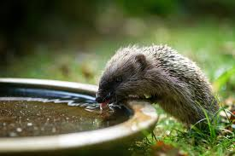
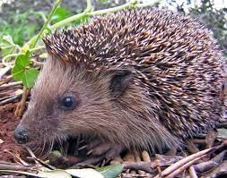
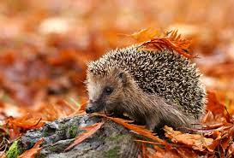
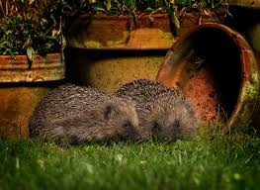
Why do hedgehogs need our help?
It’s estimated in the last two decades (20 years), hedgehog populations have fallen by up to 77%

Slide 4
Why are hedgehogs in danger?

Slide 5
Tens of thousands of hedgehogs are killed by road traffic each year.
Hedgehogs are losing their natural habitats because of urbanisation.

Slide 6
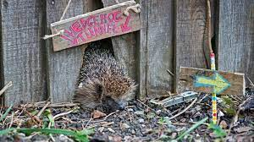
What can we do to help hedgehogs at home and school?

Slide 7
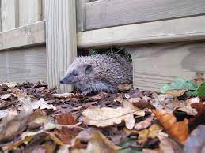
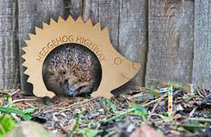
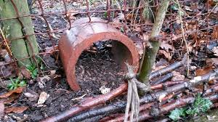
Build a hedgehog highway!
No single garden is enough; hedgehogs need neighborhoods of linked-up gardens to survive, connected by accessible and safe routes called ‘Hedgehog Highways’.
Building a hedgehog highway involves clearing a pathway and ensuring there is a garden entrance/exit point.

Slide 8
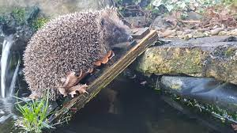
Make your pond safe with a ramp
Garden and school ponds are a real hazard for thirsty hedgehogs. They are unable to climb out of deep water!
Simple planks of wood or stacked up stones will provide a route out of trouble and an easy way for hedgehogs to access fresh water to drink.
Hedgehogs also struggle to climb up steps so keep a look out for other places a ramp might be helpful.

Slide 9
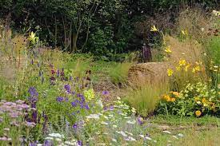
Create a wild corner
Hedgehogs build nest out of deciduous leaves and love to snuggle down under a pile of logs.
Piling up leaves and other garden cuttings in a dedicated corner of the garden gives hedgehogs a safe place to hide and sleep undisturbed.
Planting wild flowers in this area will also encourage more hedgehogs, which are an essential food source for hedgehogs.

Slide 10
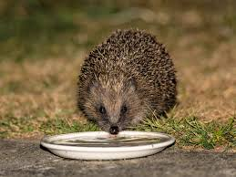
Put out food and water

Slide 11
Make a hedgehog home

Slide 12
