Slide 1
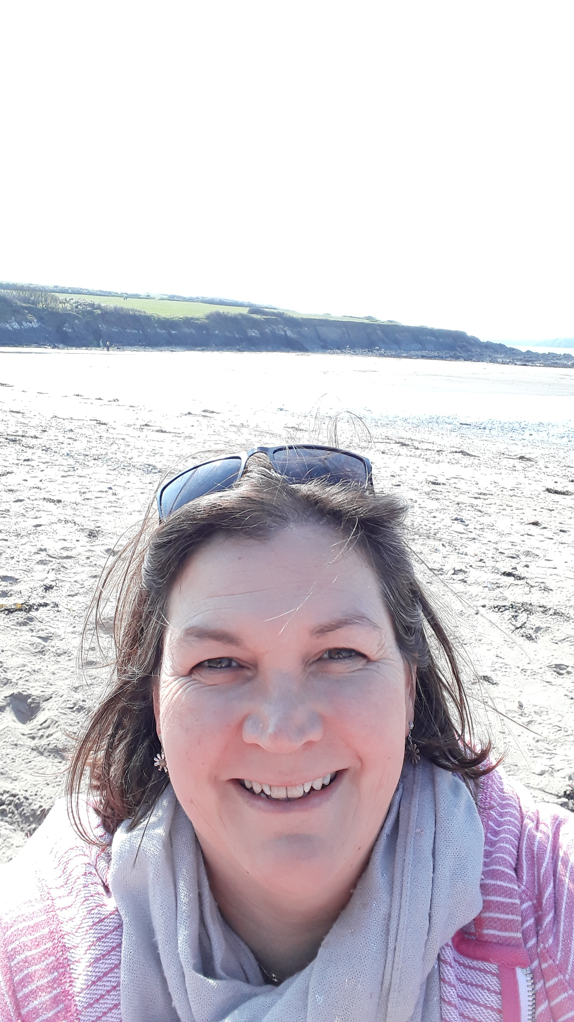
Black Lives Matter
An online assembly from Thatcham Baptist Church
Hello, I am Penny Judge and I work for Thatcham Baptist Church. This week’s assembly is about Black Lives Matter. You might have heard a lot about this in the news and on social media.

Slide 2
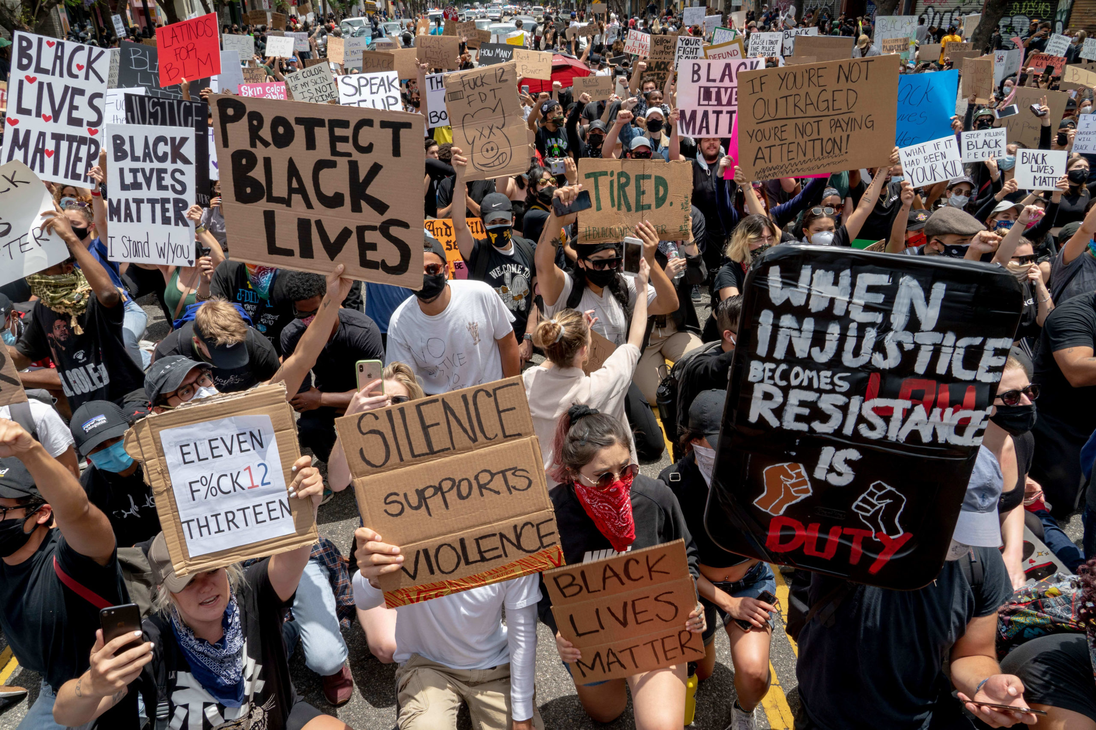
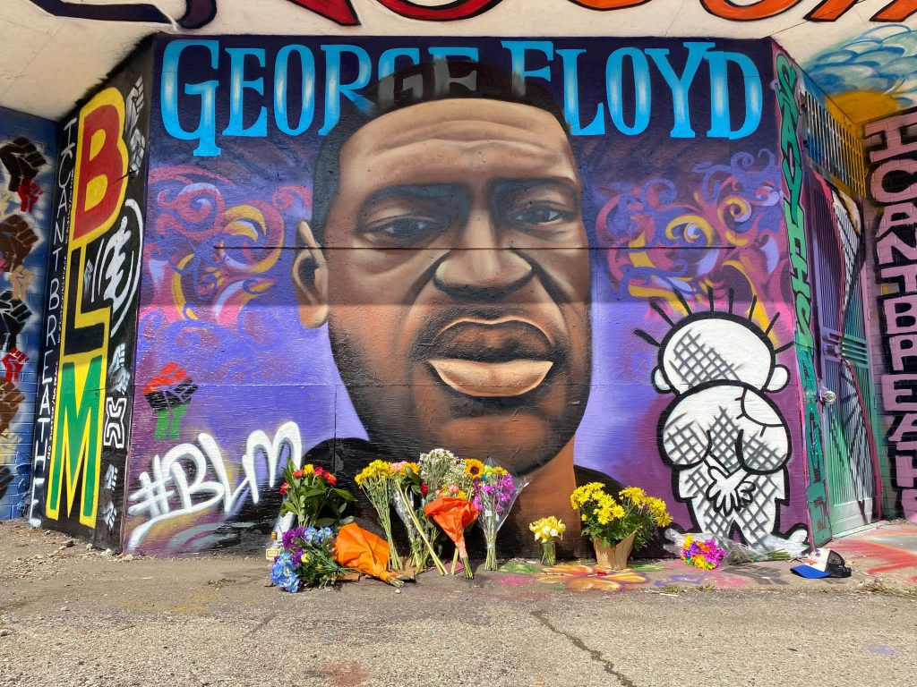
Black Lives Matter
Last week there was a lot of people talking about a man called George Floyd who was killed in America.
A lot of people were cross and upset about how he died.
It made them think about how other black people are treated.
They wanted leaders and everybody to think about how black people felt, and many people protested.

Slide 3
Black Lives Matter
When people are treated differently because of the colour of their skin, or the country they come from, or because they are different, it is called racism.
Racism is a bad thing. We should all be treated the same.
At the moment people are very sad and cross about how black people are being treated, and the Black Lives Matter campaign is making people think.
Here is a story called The Skin You Live In, by Michael Tyler.

Slide 4
The Skin You Live In by Michael Tyler
Hover your mouse around here to find the play button to watch the story.

Slide 5
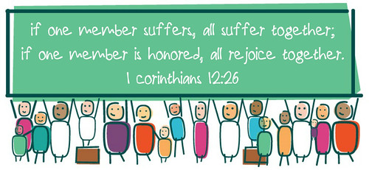
Black Lives Matter
Black people have not been treated well and many are hurting.
The Christian Bible says that the people are like a body, and if one part of the body is suffering we all suffer.
So if black people are suffering we should all feel their pain and want to do something about it.

Slide 6
Black Lives Matter
So this week reflect on the saying Black Lives Matter.
What can you do?
You could think about how black people are hurting at the moment and talk about it with others.
Perhaps you can think about friends or find out about famous black people from the past or today.

Slide 7
Black Lives Matter
If you have a faith you could say the prayer that was said at the end of George Floyd’s funeral by Pastor Bryant:
"Good and gracious God, merciful Master, walk with us while we run this race. Speak to us as we lift our voice. Use our hands so that they do not become fists. Change our hearts so that our rage will shift to rehabilitation. Convict the country so that it can finally be the land of the free and the home of the brave. We pray this prayer," he said, adding, "We march on until victory is won."

